Slide 1
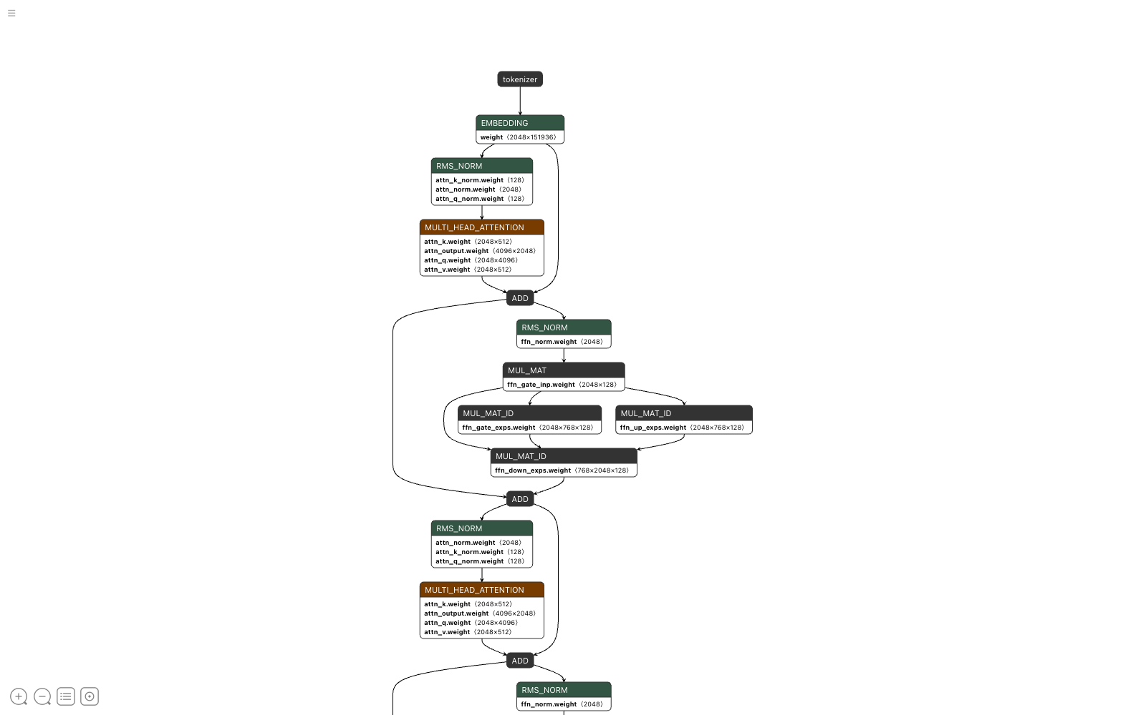
AN EDUCATIONAL COURSE
How an LLM works
A guided tour through a real model file, node by node, using the Netron viewer
Qwen3-Coder-30B-A3B-Instruct
qwen3-coder-30b.gguf · GGUF v3 · 579 tensors · 48 blocks
Notes:
Welcome. In this course we do not start from equations. We start from a real file: the 18 gigabyte Qwen3-Coder model that runs locally through Ollama. We open it in Netron, a free model viewer, and walk through what the network actually does to your text, one node at a time. Everything on these slides is a screenshot of that file.

Slide 2
What we will trace through the file
Every large language model, whatever its brand, does the same five things to your text. We follow each one in the real graph.
1
2
3
4
5
Text becomes vectors
Tokens look at each other
Each token is transformed
Repeat 48 times
Vectors become a word
Same block, different weights
Tokenizer and embedding table
Multi-head attention
Feed-forward layer, here as 128 experts
Output head, logits, next token
Qwen3-Coder-30B-A3B-Instruct · qwen3-coder-30b.gguf · rendered in Netron 9.2.8
2
Notes:
Set expectations: the five stages are universal. GPT, Llama, Claude, Qwen all follow this shape. What differs between models is the size of each stage and small design choices, some of which we will see, such as grouped-query attention and mixture-of-experts.

Slide 3
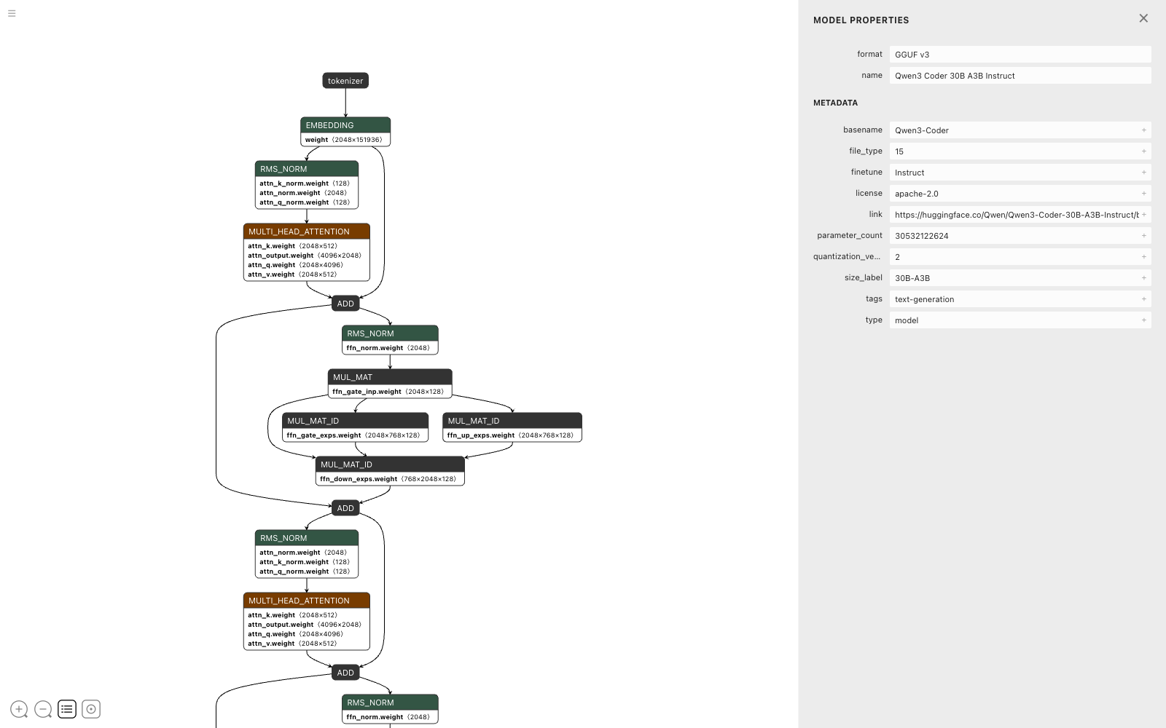
The model describes itself in its own header
A GGUF file starts with a key-value header. Netron reads it and shows it as Model Properties. No code has run yet; this is just metadata.
Key | Value
architecture | qwen3moe
parameters | 30.5 billion
active per token | about 3 billion
block_count | 48
embedding_length | 2048
context_length | 262,144 tokens
vocabulary | 151,936 tokens
file_type | 15 = Q4_K_M quantization
Qwen3-Coder-30B-A3B-Instruct · qwen3-coder-30b.gguf · rendered in Netron 9.2.8
3
Notes:
Point out the two numbers that will matter most later: embedding_length 2048 is the width of every vector flowing through the network, and block_count 48 is how many times the transformer block repeats. The name 30B-A3B means 30 billion parameters stored, about 3 billion used for any single token, which we explain on the experts slide.

Slide 4
The whole network is a graph you can read top to bottom
Data enters at the tokenizer and flows down the arrows. Every box is a real tensor stored in the file, with its shape printed beside it.
Green is normalisation. It rescales vectors.
Rust is attention. Tokens exchange information.
Dark is matrix multiply. Vectors are transformed.
ADD is a residual connection. The shortcut lines that loop around each stage.
Qwen3-Coder-30B-A3B-Instruct · qwen3-coder-30b.gguf · rendered in Netron 9.2.8
4
Notes:
Give students a minute to just look. Ask them to find the repeating pattern before you name it. The colour key is Netron's own convention, which is why the legend matches the screenshot. Note that the shapes written on nodes, like 2048 by 151936, are the actual dimensions of the stored matrices.

Slide 5
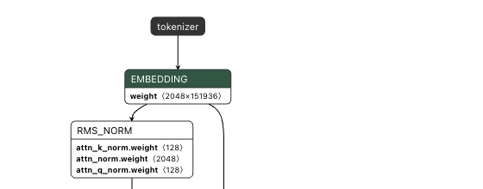
Step 1. Text becomes numbers
The tokenizer
Splits text into pieces from a fixed vocabulary of 151,936 tokens using byte-pair encoding, the same scheme the header labels as gpt2. A word may be one token or several.
The embedding table
A lookup table with one row per token. Each row is a vector of 2048 numbers. Token id in, vector out. Nothing is computed yet, it is just a read.
token_embd.weight 〈2048 × 151936〉
From here on the model never sees text again, only 2048-wide vectors. The whole rest of the graph is arithmetic on those vectors.
Qwen3-Coder-30B-A3B-Instruct · qwen3-coder-30b.gguf · rendered in Netron 9.2.8
5
Notes:
A good live demo: type a sentence into any tokenizer playground and show how it splits. Then relate the count of 151936 rows to the vocabulary size. The embedding matrix alone is 2048 times 151936, about 311 million numbers, which is why it appears at both ends of the graph: the same table is used to look words up and, at the end, to score them.

Slide 6
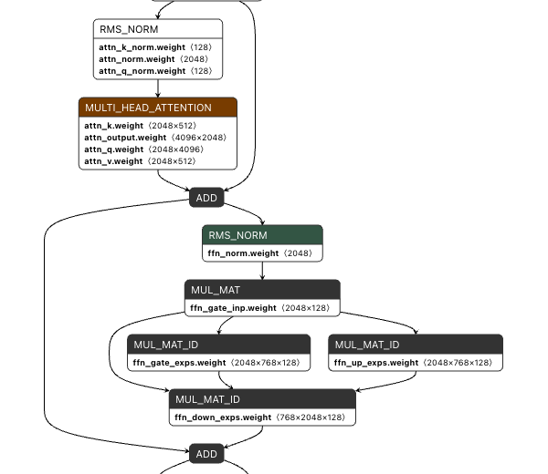
One transformer block: two stages, each wrapped in a shortcut
RMS_NORM rescales
Before each stage the vector is normalised to a steady size, then scaled by a learned weight. It keeps 48 stacked blocks numerically stable.
ADD is the residual connection
Each stage computes a correction and adds it to its own input. The long curved line is the original vector skipping past the stage.
The residual stream
Think of the 2048-wide vector as a running document. Attention and the experts each write small edits into it. Nothing ever overwrites it.
Qwen3-Coder-30B-A3B-Instruct · qwen3-coder-30b.gguf · rendered in Netron 9.2.8
6
Notes:
Trace the two shortcut lines with the pointer. The first leaves just after the embedding and re-enters at the first ADD, skipping attention. The second leaves after that ADD and re-enters at the second ADD, skipping the experts. This residual idea, from 2015 image models, is what makes very deep networks trainable.

Slide 7
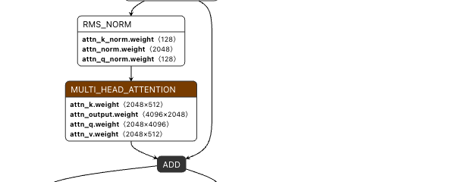
Step 2. Attention lets every token look at the ones before it
Each token asks a question (query), every earlier token offers a label (key) and content (value). Where question and label match, that content is mixed in. Four weight matrices do this, and their shapes tell the story.
attn_q 2048→4096
attn_k 2048→512
attn_v 2048→512
attn_output 4096→2048
32 query heads of 128 each. Every head asks a different kind of question.
Only 4 key heads. Eight query heads share each one: grouped-query attention.
4 value heads, matching the keys. This is the content that gets copied.
Folds the 32 heads back to 2048 so the result can be added to the stream.
Qwen3-Coder-30B-A3B-Instruct · qwen3-coder-30b.gguf · rendered in Netron 9.2.8
7
Notes:
The arithmetic check students can do themselves: 4096 divided by 128 is 32 heads, 512 divided by 128 is 4 heads. Those numbers are also in the node's attributes on the next slide. Mention that attention is causal in a language model: a token can only look backwards, which is what allows generation one token at a time.

Slide 8
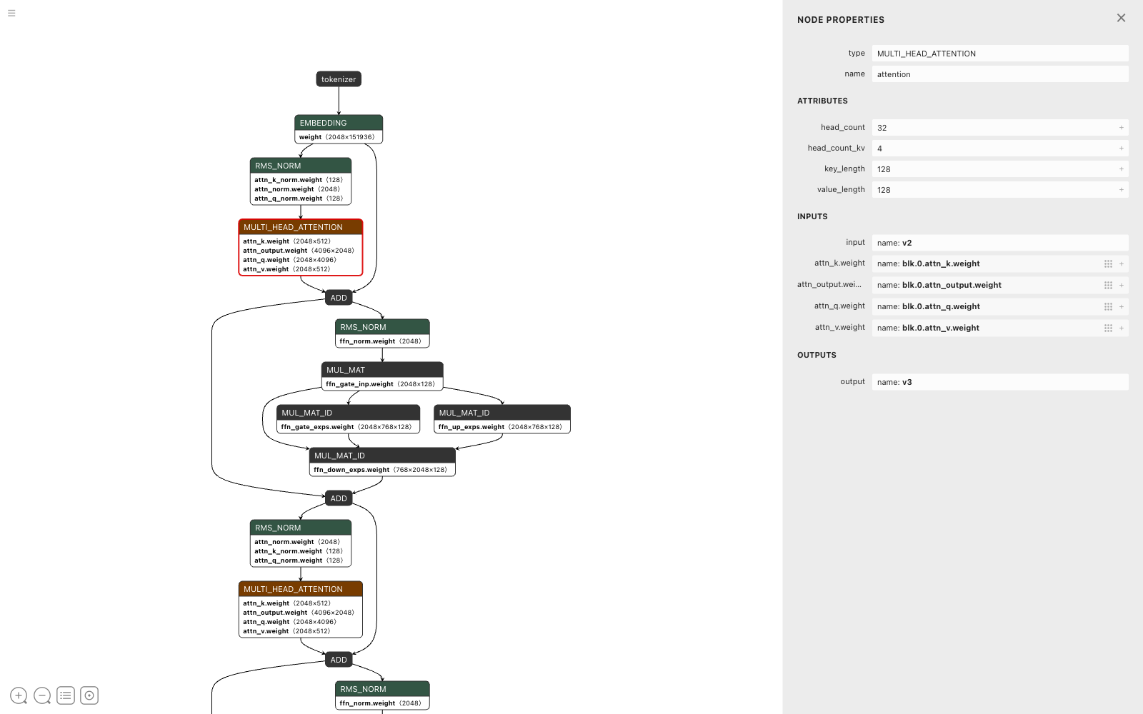
Click a node and Netron shows the design choices
attribute | value
head_count | 32
head_count_kv | 4
key_length | 128
value_length | 128
Why fewer key and value heads?
During generation the model caches every past token's keys and values. With 4 heads instead of 32 that cache is 8 times smaller, which is what makes a 262,144-token context fit in memory.
Qwen3-Coder-30B-A3B-Instruct · qwen3-coder-30b.gguf · rendered in Netron 9.2.8
8
Notes:
This is the slide where the tool becomes the teacher. Encourage students to open the file themselves and click nodes. The inputs list names the exact tensors, blk.0.attn_q.weight and so on, where blk.0 means block zero. Every one of the 48 blocks has its own copy of these four matrices.

Slide 9
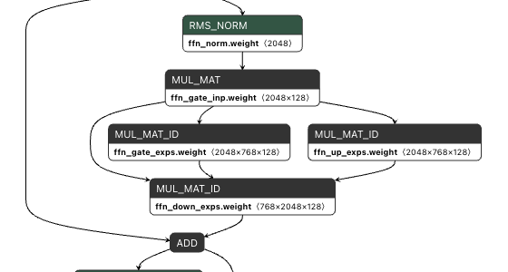
Step 3. The feed-forward layer, split into 128 experts
MUL_MAT ffn_gate_inp 〈2048×128〉
The router. It scores the token against all 128 experts and keeps the top 8.
MUL_MAT_ID gate, up 〈2048×768×128〉
128 small networks stacked in one tensor. The ID means only the chosen 8 run. Each widens the vector to 768 and applies a gate.
MUL_MAT_ID down 〈768×2048×128〉
Projects back to 2048. The 8 results are weighted by the router and summed into the stream.
This is the whole trick behind 30B-A3B: all 30 billion parameters live on disk, but any single token only touches about 3 billion of them. A dense model would have one big MUL_MAT here instead.
Qwen3-Coder-30B-A3B-Instruct · qwen3-coder-30b.gguf · rendered in Netron 9.2.8
9
Notes:
The header keys behind this are expert_count 128 and expert_used_count 8. The feed-forward stage is where most of a model's factual knowledge is believed to be stored, so splitting it into experts is a way to hold more knowledge without paying for it on every token. Mention the trade-off: the full 18 GB must still be in memory, only the compute is saved.

Slide 10
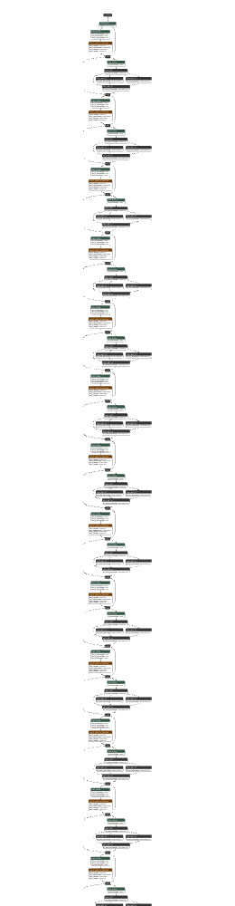
Step 4. The same block, 48 times in a row
Zoomed out, the graph is a single column of identical blocks. Each has the same structure but its own weights. Block 0 sees raw embeddings, block 47 sees a vector every earlier block has already edited.
blk.0.attn_q.weight
blk.1.attn_q.weight
…
blk.47.attn_q.weight
Depth is where behaviour emerges. Early blocks tend to handle syntax and local patterns, later blocks handle meaning and long-range structure. Nobody programs this; it is learned during training.
Qwen3-Coder-30B-A3B-Instruct · qwen3-coder-30b.gguf · rendered in Netron 9.2.8
10
Notes:
The narrow strip on the left is the real graph zoomed all the way out; you can see roughly 13 of the 48 blocks in one screen height. A useful exercise: have students count tensors per block in Netron. Each block here holds 12 tensors, and 48 times 12 plus the 3 shared tensors gives the 579 tensors reported in the header.

Slide 11
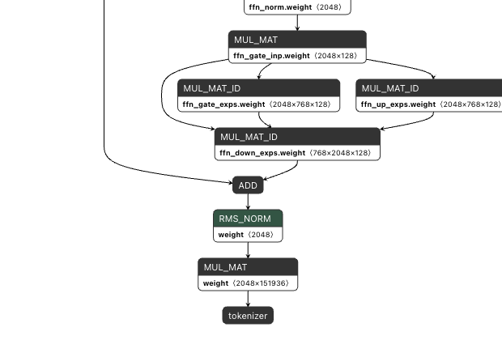
Step 5. Vectors become a probability over every word
1
Final RMS_NORM. One last rescale of the residual stream after block 47.
2
Output MUL_MAT, 2048 → 151,936. The embedding table in reverse: one score, a logit, for every token in the vocabulary.
3
Softmax and sample. Scores become probabilities. Temperature and top-p decide how adventurous the pick is.
4
Back to the tokenizer. The chosen token is appended to the input and the whole graph runs again. That loop is what you watch as text streams out.
Qwen3-Coder-30B-A3B-Instruct · qwen3-coder-30b.gguf · rendered in Netron 9.2.8
11
Notes:
Emphasise that the model produces exactly one token per full pass and knows nothing about the sentence it is going to write. The arrow back to the tokenizer at the very bottom of Netron's graph is the generation loop. This is also where students can connect settings they have seen in chat apps, temperature and top-p, to a concrete place in the pipeline.

Slide 12
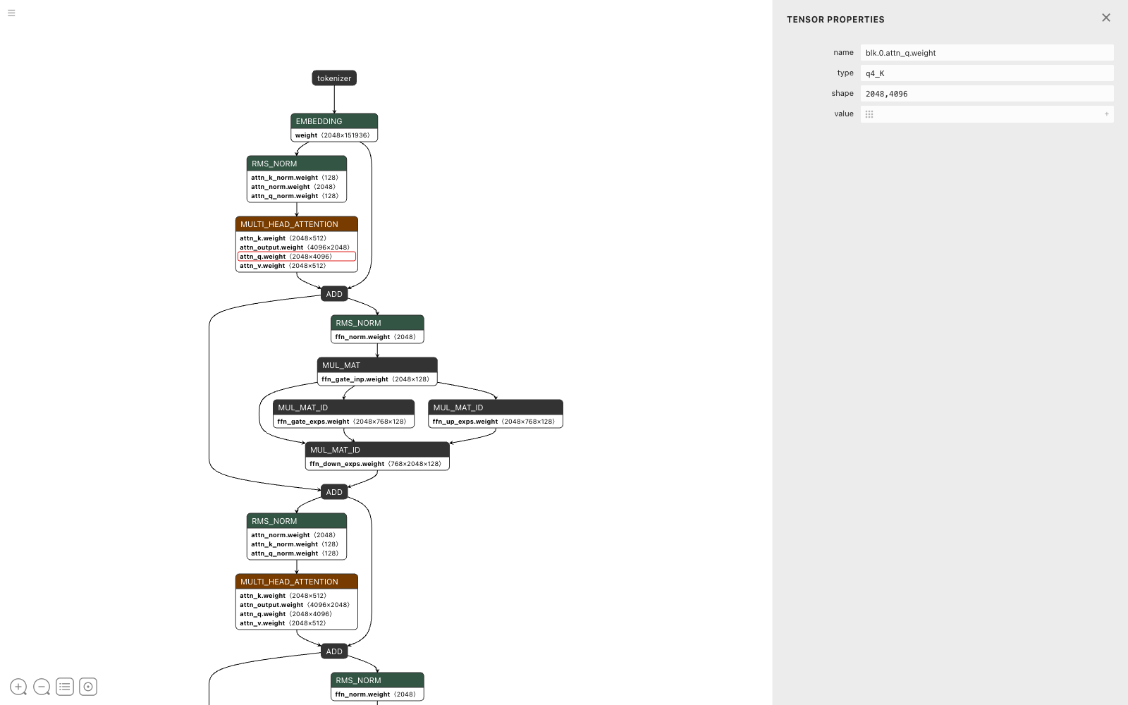
Why 30 billion parameters fit in 18 gigabytes
Click any weight and Netron shows its storage type. This query matrix is q4_K: each number is kept in about 4.5 bits instead of the 16 it was trained with.
Format | Size of this model
16-bit floats, as trained | about 61 GB
Q4_K_M, this file | about 18 GB
Q4_K_M is a mix: most big matrices are q4_K, a few sensitive ones such as attn_v and the expert down projections are q6_K, and the tiny norm weights stay full 32-bit float.
Qwen3-Coder-30B-A3B-Instruct · qwen3-coder-30b.gguf · rendered in Netron 9.2.8
12
Notes:
Quantisation is why local LLMs are possible on a laptop. The 61 GB figure is 30.5 billion parameters times 2 bytes. Netron labels each tensor's type in the graph itself too, hover over any weight row to see q4_K, q6_K or float32. A discussion point: quality loss from 4-bit quantisation is small but not zero, and heavier quantisation such as Q2 degrades noticeably.

Slide 13
THE WHOLE FORWARD PASS
tokens → embed →
[ norm → attention → add → norm → experts → add ] × 48
→ norm → logits → sample one token → repeat
It is arithmetic. Every node in Netron is a matrix multiply, an add, or a rescale.
It is one token at a time. The graph runs once per output token and feeds itself.
The shapes are the design. Head counts, expert counts and widths are all readable from the file.
Notes:
Read the mono line aloud slowly. Then ask students to point to where each word in it lives on the Netron overview from slide 4. If they can do that, they have the mental model of a transformer.

Slide 14
Try it yourself: open any model in Netron
1
Install Netron from netron.app, or with Homebrew as the netron cask. It runs fully offline.
Exercises for students
2
Find a model file. Ollama keeps its GGUF blobs under the models folder in your home directory; Hugging Face hosts thousands more.
Open a dense model such as Qwen3-8B. What replaces the MUL_MAT_ID expert nodes?
Find head_count and head_count_kv in a Llama model. Is it grouped-query attention too?
Compute the embedding table size from its shape. How many parameters is that?
Open a Q8 and a Q4 version of the same model. Which tensors change type, and which do not?
Count the tensors in one block and check the total against the header.
3
Open it. Click a node for its attributes, click a weight for its shape and storage type, use the zoom buttons to see the whole stack.
4
Compare two models side by side and explain every difference you find using the five steps from this course.
Qwen3-Coder-30B-A3B-Instruct · qwen3-coder-30b.gguf · rendered in Netron 9.2.8
14
Notes:
Netron's browser build loads the whole file into memory, so for a large GGUF use the desktop app, which streams from disk. The exercises escalate: the first two are reading, the third is arithmetic, the last two need comparison across files. Each answer is verifiable by clicking in Netron, which is the point of teaching this way.

